Slide 1



Department of Computer Science and Engineering Machine Learning With Python Tittle: Crop Yield Prediction
Vivekanandha college of engineering for women (Autonomous)
Team Members:
Pandi kavya[19101074]
Thathireddy Pushpalatha[19101113]
Yegireddy Deekshitha[19101124]
Guide Details:
MS.B.Ananthi(AP/CSE)
M.E(Ph.D)

Slide 2
COMPANY DETAILS
Accent Techno Soft (ATS) provides a wide range of solutions in IT Consulting, technology and Operations space for the clients.
Accent was founded by experienced software professionals and providing the foundation for the company's expertise in E-commerce/Web applications, custom application development, data warehousing, enterprise management solutions, and operations management (support, maintenance, implementation).
Accent Techno Soft, specialize in the business of software Training & HR Consultancy spotlighting in India.
TECHNOLOGIES OFFERED BY ATS
JAVA/J2EE, Perl/Python, Web Designing

Slide 3
CONTENTS
Introduction to Machine Learning
Abstract
Introduction
Existing System
Proposed system
Number of Modules
Screenshot of Implementation
Conclusion
References

Slide 4
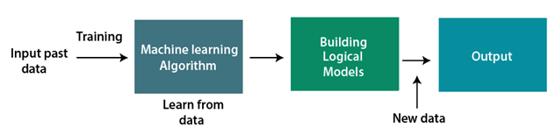
INTRODUCTION TO MACHINE LEARNING
Machine learning is a growing technology which enables computers to learn automatically from past data. Machine learning uses various algorithms for building mathematical models and making predictions using historical data or information.
Currently, it is being used for various tasks such as image recognition, speech recognition, email filtering, Facebook auto-tagging, recommender system.
Machine learning techniques such as Supervised, Unsupervised, and Reinforcement learning.

Slide 5
ABSTRACT
The impact of climate change in India, most of the agricultural crops are being badly affected in terms of their performance over a period of the last two decades. Predicting the crop yield in advance of its harvest would help the policy makers and farmers for taking appropriate measures for marketing and storage. This project will help the farmers to know the yield of their crop before cultivating on to the agricultural field and thus help them to make the appropriate decisions. It attempts to solve the issue by building a prototype of a prediction system The results of the prediction will be made available to the farmer. By analysing all these issues and problems like weather, temperature, humidity, rainfall, moisture, the situation faced by us.
In India, there are many ways to increase the economic growth in the field of agriculture.

Slide 6
INTRODUCTION
Agriculture plays an important role in the growth of the national economy. Some of the factors on which farming depends on are Soil, Climate, Humidity, Rainfall, Temperature and so on.
Most of the times, farmers fail to achieve the expected result due to many reasons. Yield prediction is carried out which involves predicting the yield of the crop based on the existing data.
In the past, prediction were mainly based on the farmers previous experiences.
Yield prediction helps in identifying the most feasible crops to be cultivated for a particular crops according to given environmental conditions.

Slide 7
EXISTING SYSTEM
Currently, there exists no automated system for this purpose which takes a consideration both the climatic and soil factors for prediction of yield.
This leaves space for errors which are inevitable Factors such as uncertain feature weather and soil are not considered while making choices which could cost heavily.
The proposed system focuses on automating the prediction of crop yields by taking into consideration the climatic conditions and soil data.

Slide 8
PROPOSED SYSTEM
In the proposed method, initially the raw data set was collected and it is subjected to
preprocess for noise removing (replacement of missing values) and computational methods.
From that dataset, it is subjected to Feature selection for make a predictive modeling.
In this proposed approach it is mainly focused on Regression Techniques. Various regression analysis should be performed and it was compared and tested.

Slide 9
Regression analysis is a form of predictive modeling technique which investigates the association between a dependent (target) and independent variable(s) (predictor).
This technique is used for forecasting, time series modeling and discovers the causal effect relationship between the variables. Regression analysis indicates the significant relationships between dependent variable and independent variable and it indicates the strength of impact of multiple independent variables on a dependent variable.
These techniques are typically motivated by 3 metrics. They are number of independent variables, type of dependent variables and regression line pattern shape.

Slide 10
System Design 1
Location
Input
Soil
Area(In Acres)
Data Preprocessing
Data
Transformation
Crop
Output
Yield

Slide 11
System Design 2
Features
Train the data
Data
Transformation
Apply machine learning classifiers
Predict the crop and yield

Slide 12
NUMBER OF MODULES
1)Dataset collection
2)Pre-processing the data
3)Transforming the data

Slide 13
1 Dataset collection
➢ The dataset used for this project is collected from online sources like Kaggle.com
➢ Some important features or the parameters which has the highest impact on the agricultural yield considered in the project are listed below:

Slide 14
Rainfall
Humidity
Temperature
Area
Yield
Type of the soil
Location

Slide 15
2 Pre-processing the data
• After the selection of the dataset, it has to be pre-processed into a form that you can work with. Some of the steps are formatting, cleaning and sampling.
• Initially the data have selected is converted into the format suitable for you to work with.
• Cleaning data is the removal or fixing of the mixed data. Sampling is taking a small representative sample of the selected data that may be much faster for exploring the solutions than electing the whole dataset

Slide 16
3 Transforming the data
• The final step is transforming the selected data. The pre-processed data here is then transformed into data that is ready for machine learning algorithms by using various engineering features like scaling, feature aggregation and so on.
• There may be several features that can be combined into a single feature which would be more meaningful to the problem you are trying to solve.

Slide 17
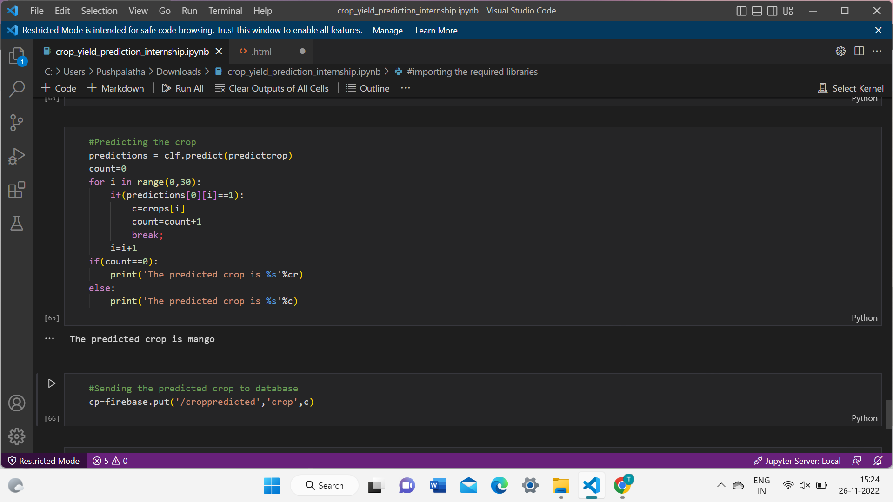
1.2 The prediction crop is Mango

Slide 18
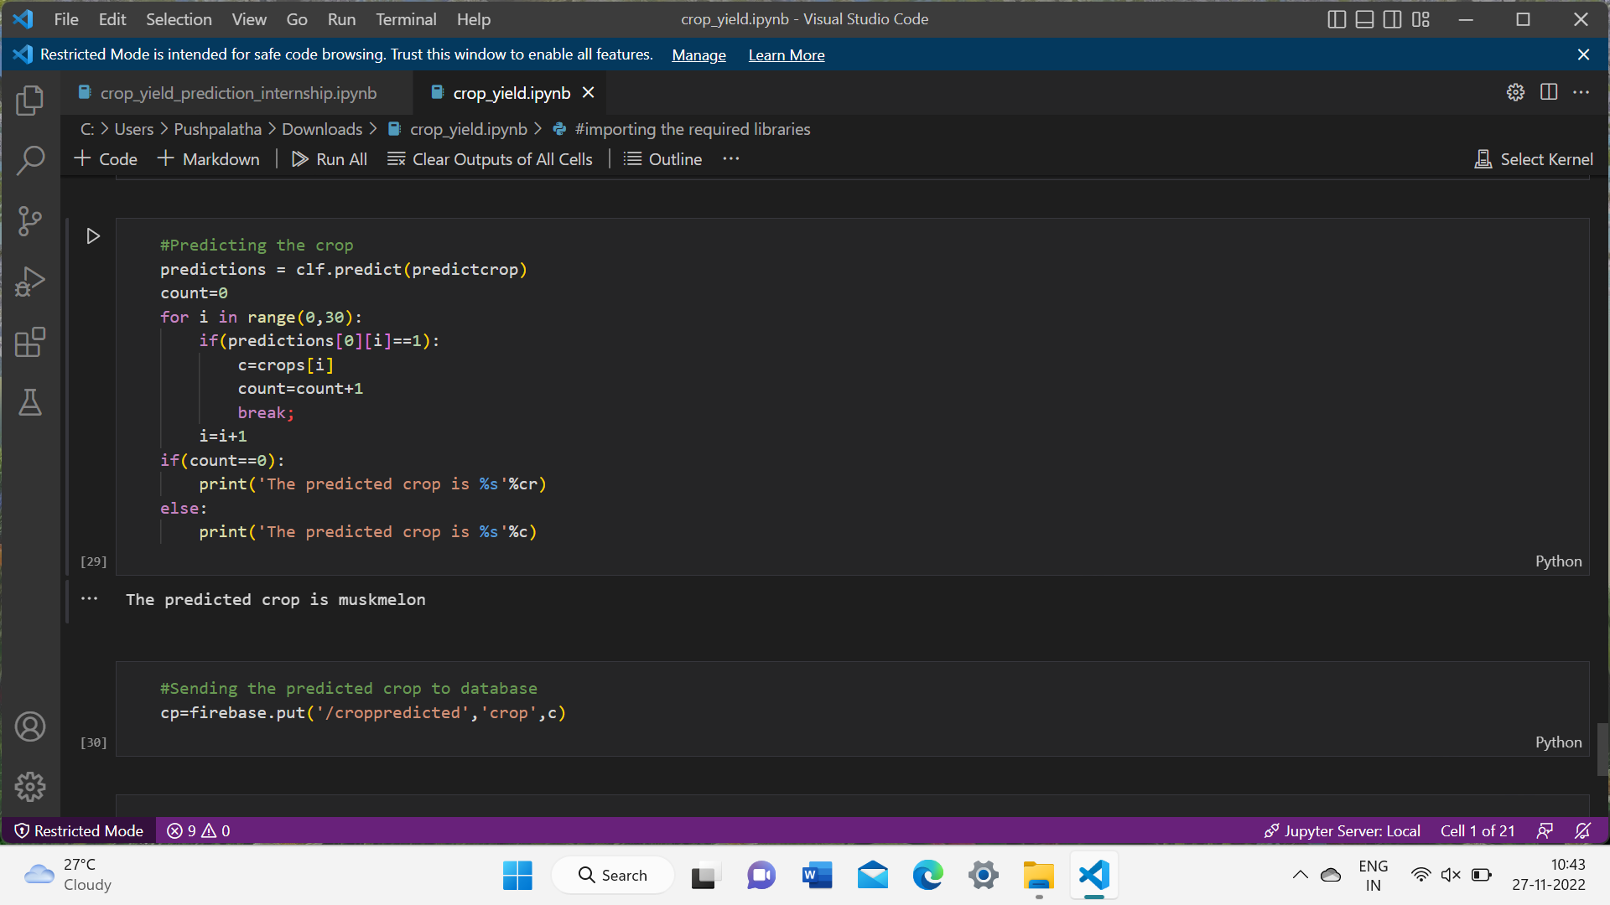
SCREENSHOT OF IMPLEMENTATION
1.1 The prediction crop is muskmelon

Slide 19
CONCLUSION
This system is proposed to deal with the increasing rate of farmer suicides and to help them to grow financially stronger. The Crop Recommender system helps the farmers to predict the yield of a given crop and also helps them to decide which crop to grow. Moreover, it also. Appropriate datasets were collected, studied and trained using machine learning tools. Thus, the user needs to provide limited information like the soil type and area.

Slide 20
REFERENCES
https://ieeexplore.ieee.org/document/9432236
GitHub
SlideShare
Datasets :
https://www.kaggle.com/

Slide 21

CERTIFICATES

Slide 22
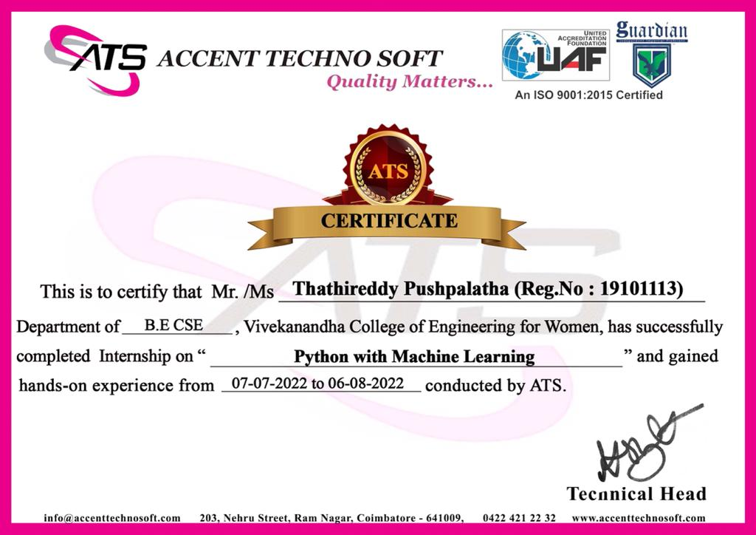

Slide 23


